Slide 1
Disaster Preparedness & Recovery Mental/Behavioral Health Issues/Gaps and Planning and Response CALBHBC – Los Angeles Friday - June 22, 2018
Howard Backer, MD, MPH
Director, California Emergency Medical Services Authority
Patti Carter, BA, EMT
Public Health Coordinator – Nevada County
Merritt D. Schreiber, Ph.D. Professor of Clinical Pediatrics – Harbor UCLA MC Sandra Stark Shields, LMFT, LPCC
Sr. Disaster Analyst – LA County DMH DSU

Slide 2
Topics we will Discuss
Disaster-Related MH/BH Spectrum: Individual Needs & Appropriate Levels of Care
The place of Mental/Behavioral Health in the Structure of Emergency Response Organizations (State and Local)
Challenges and Recommendations in Disaster Mental/Behavioral Health Planning and Response

Slide 3
Disaster-Related MH/BH Spectrum: Individual Needs & Appropriate Levels of Care
Sandra Stark Shields, LMFT, LPCC
Sr. Disaster Analyst – LA County DMH DSU

Slide 4
Overview – Disaster Mental Health
“Disasters can occur naturally (such as tornadoes, hurricanes, earthquakes, floods, wildfires, mudslides, or drought) or be human-caused (such as mass shootings, chemical spills, or terrorist attacks). Preparing for, responding to, and recovering from disasters and traumatic events is essential to the behavioral health (mental health and substance use) of individuals and communities. When people experience a disaster, they may experience a variety of reactions … most people show resilience after a disaster…” SAMHSA https://samhsa.gov/disaster-preparedness
“A number of risk factors make it more likely that someone will have more severe or longer-lasting stress reactions after disasters…”
https://www.ptsd.va.gov/public/types/disasters/effects_of_disasters_risk_and_resilience_factors.asp

Slide 5
Some Disaster MH History
Cerritos Air Crash in 1986 was the watershed event
1992 Disaster Mental Health function established at the American Red Cross in the wake of Hugo and the Loma Prieta Earthquake
DMH/BH Departments entered the disaster response business more proactively at that time as well

Slide 6
California – Many Large Disasters!
2017 Wildfires Historic levels of death and destruction = 1.2 million acers destroyed, 10, 800 structures, killing 46 people. Thomas fire was the largest recorded wildfire in CA (Washington Post)
Floods – Oroville Dam, Sonoma, Mendocino, Guerneville, Ventura, Santa Barbara, Los Angeles
Public Health disasters (Hepatitis A, Exide, Sativa Water, etc) = always a BH impact!
Shootings - Las Vegas Shooting (also Waterman/San Bernardino) = Care of Employees a big factor

Slide 7
Disaster Mental Health - Assumptions
Most reactions to disaster are common and expected
Most people are resilient and will recover on their own but some will require follow up.
Disaster MH interventions can help facilitate recovery and mitigate long-term psychological challenges (e.g., depression, anxiety, PTSD).
American Red Cross provides crisis intervention – but not long term BH treatment.
County BH/MH departments are tasked with providing crisis and longer term BH/MH services

Slide 8
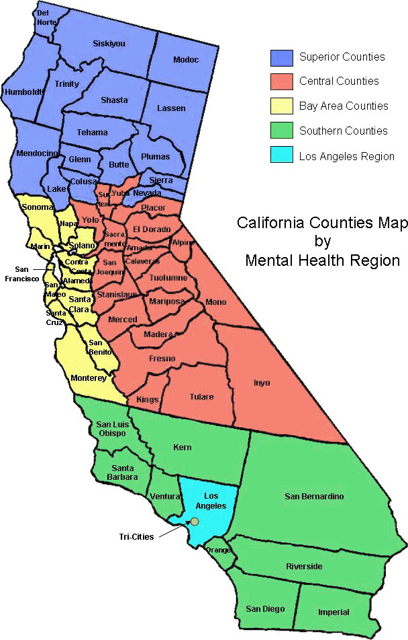
58 BH/DMH Departments in CA
Each County is different
Not all departments have dedicated disaster planning staff, professional emergency managers, and/or Disaster BH expertise
Not all counties have the same disaster BH Mission, evidence-informed BH interventions, trained staff, integration into Medical and Health plans, or partnerships (such as with the American Red Cross)
Notes:
Map Source: County Behavioral Health Directors Association (CBHDA)

Slide 9
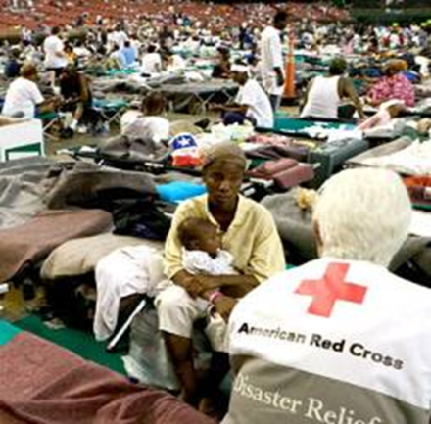
Where are Disaster Mental Health Services Provided?
Wherever disaster survivors/clients are:
Shelters
Service Centers (established temporarily
in community settings)
LACs, FAC’s, Community meetings
Hospitals, Public Health PODs
Wherever disaster responders are:
Shelters
Service Centers
Emergency Operations Centers (EOC)

Slide 10
Type of BH/MH Staff Who Respond
Licensed MH Professionals, Nurses
Registered MH Interns, etc
No paraprofessionals are used for mutual aid (county to county deployments) but Counties can choose to use them
Counties might consider adding Certified Drug and Alcohol Counselors for tasks within their scope – but not as Disaster Mental/Behavioral Health responders.
Spiritual Care providers can “partner” with BH

Slide 11
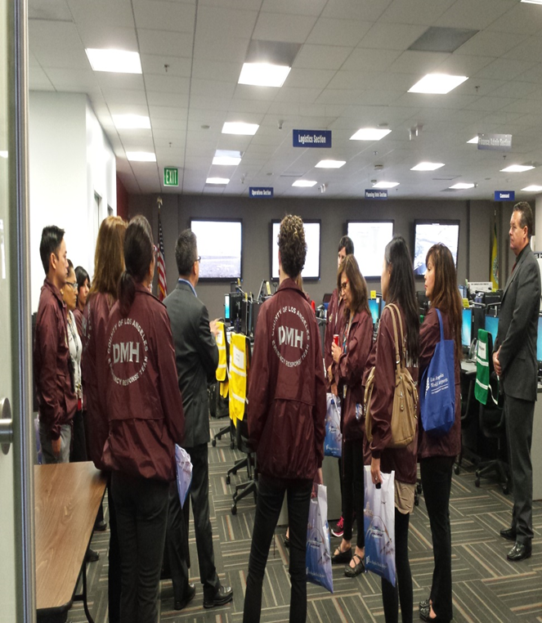
Common BH/MH Field Interventions
Psycho-education Model
Community Meetings
Psychological First Aid
Crisis Intervention
Crisis Counseling
Linkage, Advocacy and Referrals into the County MH system (for longer term counseling services)

Slide 12
Severity vs. Treatment – Not “One size fits all”
Severity
Treatment
Resiliency
Concerns, Behavior Change
Non-specific psychological distress
Traumatic Bereavement, Acute Stress Disorder
PTSD, Depressions, Anxiety, Panic, etc
Nothing PFA
PFA, Psycho-Education, Support systems
Assessment, Crisis Counseling, etc
Short Term counseling – TF-CBT, etc
Long Term (trauma) treatment/psychotherapy

Slide 13
County Staff Impact
Mission of Disaster Mental/Behavioral Health ALSO includes support for County staff
Employee Health and Well Being Unit Leader position in the County EOC should be added.
Services beyond Employee Assistance Program (EAP) will be needed for disasters impacting staff.
Rules on access to Victim of Crime Services for Employees were changed after the Waterman/San Bernardino shooting

Slide 14
Disaster-Related MH/BH Spectrum: Individual Needs & Appropriate Levels of Care
Merritt D. Schreiber, Ph.D. Professor of Clinical Pediatrics – Harbor UCLA MC

Slide 15
Behavioral Health and Medical/Health (ESF 8) Mutual Aid System
Howard Backer, MD, MPH, FACEP
Director, Emergency Medical Services Authority

Slide 16
Spectrum of Behavioral Health Response
Evaluation of mental health needs
Existing mental health problems
New stress response among public
Stress response among rescuers
Psychiatric medications and Drug rehabilitation
Response to public health and disaster messaging
Support health care and shelter operations

Slide 17
So Cal Catastrophic Earthquake Estimate (8 county region affected, 2010)
Pre-existing mental health needs:
7% of general population is on medication for a diagnosed mental health disorder
1,146,239 severely mentally ill adults and severely emotionally disturbed children
Dept State Hospitals in affected region
Patton State Hospital patient population = 1287
Metropolitan State Hospital population = 1041
72hr involuntary hold (5150) average = 200 / day
Notes:
Source CA Dept Mental Health [DMH], 2010
"seriously emotionally disturbed children or adolescents" means minors under the age of 18 years who have a long-term mental disorder other than a primary substance use disorder or developmental disorder, which results in behavior inappropriate to the child's age according to expected developmental norms, and results in substantial impairment in self-care, school functioning, family relationships, or ability to function in the community; at risk of removal from home or has already been removed from the home; displays psychotic features; meets special education eligibility requirements.
“serious mental disorder” is a disorder severe in degree and persistent in duration, which may cause behavioral functioning that interferes substantially with the primary activities of daily living, and that may result in an inability to maintain stable adjustment and independent functioning without treatment, support, and rehabilitation for a long or indefinite period of time.

Slide 18
Response Principles Public Health and Medical (ESF-8)
Standardized Emergency Management System (SEMS) compliant
Local Operational Control and Response
State Responsible for Resource Assistance
Federal support for resources, management
Coordinate/integrate private and public partners
Mutual aid based on needs and requests
Need is immediate with resource gap
Recovery is much longer than initial response

Slide 19
Medical Health Operational Area Coordination (MHOAC) Program Health & Safety Code 1797.153
County health officer and local EMS administrator or their joint appointee
17 Functions – may be delegated
Single Point of Contact for coordination with the RDMHC/S, EMSA and CDPH
Situation Status Reporting
Resource Requests
Notes:
17 functions:
(1) Assessment of immediate medical needs.
(2) Coordination of disaster medical and health resources.
(3) Coordination of patient distribution and medical evaluations.
(4) Coordination with inpatient and emergency care providers.
(5) Coordination of out-of-hospital medical care providers.
(6) Coordination and integration with fire agencies personnel, resources, and emergency fire prehospital medical services.
(7) Coordination of providers of nonfire based prehospital emergency medical services.
(8) Coordination of the establishment of temporary field treatment sites.
(9) Health surveillance and epidemiological analyses of community health status.
(10) Assurance of food safety.
(11) Management of exposure to hazardous agents.
(12) Provision or coordination of mental health services.
(13) Provision of medical and health public information protective action recommendations.
(14) Provision or coordination of vector control services.
(15) Assurance of drinking water safety.
(16) Assurance of the safe management of liquid, solid, and hazardous wastes.
(17) Investigation and control of communicable disease.

Slide 20
17 functions of the MHOAC (HSC 1797.153)
(1) Assessment of immediate medical needs.
(2) Coordination of disaster medical and health resources.
(3) …patient distribution and medical evaluations.
(4) Coordination with inpatient and emergency care providers.
(5) Coordination of out-of-hospital medical care providers.
(6) Coordination and integration with fire agencies personnel, resources, EMS.
(7) Coordination of non-fire based prehospital EMS.
(8) …establishment of temporary field treatment sites.
(9) …surveillance and epidemiological analyses of community health status.
(10) …food safety.
(11) …exposure to hazardous agents.
(12) …mental health services.
(13) ..public information health and medical protective actions.
(14) …vector control services.
(15) …drinking water safety.
(16) …management of liquid, solid, and hazardous wastes.
(17) …control of communicable disease.

Slide 21
Regional Disaster Medical Health Coordination (RDMHC/S) Health & Safety Code 1797.152
Health officer, EMS administrator or medical director, or emergency services coordinator
appointed by Directors of CDPH and EMSA
RDMHS: shared position by EMSA and CDPH
Coordinates disaster medical and health resources in the Region
Manages and improves the Region’s medical/health mutual aid and mutual cooperation
Supports local medical/health response system

Slide 22
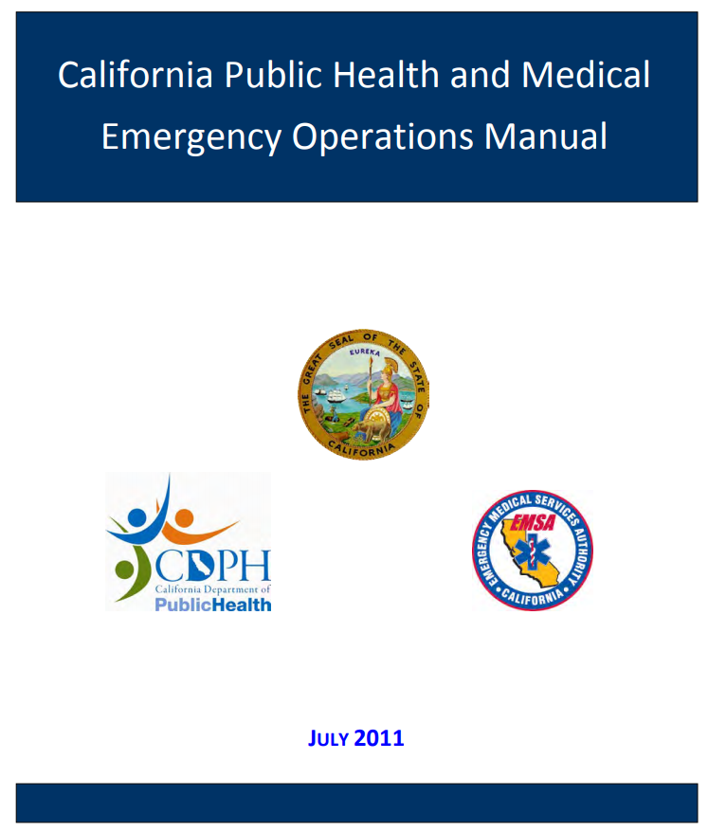
The EOM establishes a coordinated system to provide public health and medical resources, e.g., medical equipment and supplies, medical transportation, or healthcare personnel from both the private and public sectors to requesting local jurisdictions impacted by the disaster. State Emergency Plan 2017
Revision 2018
Revision 2018

Slide 23
Emergency Operations Manual
Strengthens local-state coordination for Public Health and Medical during emergencies
Builds a common operational framework
Supports assistance to local governments or Operational Areas
Describes roles and activities within ESF 8 and coordination with emergency management
Standardizes operational processes in ESF 8
situation status reporting
resource requests

Slide 24
County Mental Health Agency (Activities designated in EOM)
During an unusual event or emergency involving behavioral health
Notify MHOAC and necessary agencies
Determine resource needs
Engage and report to DOC and/or EOC if requested
Help provide behavioral health public messaging to community
Deploy personnel
If Presidential declaration, pursue Stafford Act resources

Slide 25
State Agencies and Resources
DHCS
Division of Mental Health and Substance Use Disorder Services (MHSUDS)
CDPH
EMSA
Disaster Healthcare Volunteers
Medical Reserve Corps mobilization / coord
Cal OES
California National Guard
20-30 behavioral health providers
EMAC (State to state mutual aid)

Slide 26
Federal Resources: Grants, benefits, technical assistance U.S. Department Health and Human Services (HHS)
Substance Abuse and Mental Health Services Administration (SAMHSA)
Crisis Counseling Assistance and Training Program (CCP--with FEMA)
Specialized Crisis Counseling Services
funds for up to 60 days of services immediately following a Presidential disaster declaration
Regular Services Program grant--funds for up to additional 9 months
Disaster Technical Assistance Center
Disaster Behavioral Health Information Series
Disaster Distress Helpline (DDH) – 1-800-985-5990

Slide 27
Federal Resources
Assistant Secretary for Preparedness (ASPR)
NDMS has over 100 deployable mental health personnel
Commissioned Corps Officers (Surgeon General)
150 Commissioned Corps mental health providers
American Red Cross
8,000 Licensed mental health personnel plus trained laypersons
Services at shelters, service centers, bulk distribution routes, aid stations and temporary evacuation points
CDC
Post disaster surveillance and needs assessment
Notes:
memoranda of understanding with the American Psychological Association, American Psychiatric Association, National Association of Social Workers, American Counseling Association, American Association of Marriage and Family Therapists, and several others, to utilize members of all of the major professional mental health associations for service as ARC disaster mental health volunteers. In concert with government partners and other health care providers, health and mental health workers the American Red Cross provides services at shelters, service centers, bulk distribution routes, aid stations and temporary evacuation points.

Slide 28
Challenges and Recommendations in Disaster Mental/Behavioral Health
Patti Carter, BA, EMT
Public Health Coordinator – Nevada County
Sandra Stark Shields, LMFT, LPCC
Sr. Disaster Analyst – LA County DMH DSU

Slide 29
Challenges for BH/MH Departments
Lack of funding and dedicated and trained Emergency Management staff and Disaster MH/BH expertise.
Integration of BH staff into the Med/Health Branch, Public Health and Health plans, and into exercises and drills
“Psychological Casualty” numbers are not included in drills and exercises = no opportunity for BH Departments to practice!
Need for statewide facilitation to help develop:
DMH/BH tools for disaster planning and response
Consensus on “required” training – including specific training for BH roles in different types of disasters
Implement CA Public Health & Medical BH Resource Typing Tools
Evidence-Informed BH Intervention Standards
California (Methadone) Clinic Plan

Slide 30
What the CALBHBC can do to help #1
Assess the level of Disaster Response Preparedness for your County’s Disaster Behavioral Health response:
How is Mental/Behavioral Health integrated, staffed, funded and supported in your County? On par with Public Health and Health in your jurisdiction? If not, why not?
Professional Emergency Management staff dedicated full time to disaster response planning? Does your county have a Disaster MH/BH Subject Matter Expert?
Current, written disaster plans? Integrated?
Disaster Department Operations Center?
Staff identified for NIMS Roles? Trained? Equipment?
DOC Activation for minor as well as major disasters? When?

Slide 31
What the CALBHBC can do to help #2
What are the Disaster BH Intervention Standards for those who are least impacted to most impacted? (Beyond PFA and “debriefing”)
What is your BH Department’s Disaster Mission?
What is the working relationship like with American Red Cross - Disaster Mental Health Services in your County?
What are the BH plans for County staff disaster mental health? (Employee Health and Well Being Unit Leader selected and trained?)

Slide 32
What the CALBHBC can do to help #3
AB2333 – Counties would greatly benefit from having a dedicated Disaster Mental/Behavioral Health Director in the appropriate state agency tasked with Public Health, Medical response, or Emergency Management to facilitate statewide BH disaster response planning and to help with the development and implementation of BH Guidance (EOM and Resource Typing), Tools, Training, and integration with the Public Health and Medical disaster response systems.

Slide 33
Want to Learn More About Disaster Mental/Behavioral Health?
BH Chapter of the EOM (Updated)
State of CA M/BH Disaster Framework (December, 2012) Developed by consensus – funded by CA HHS Agency and supported by CDPH, CDHCS and EMS Authority in 2011-12: http://www.cdmhc.org/framework.pdf
“Recommended Actions Steps for Preparedness, Response and Recovery” are helpful for County plans
CAMFT – Crisis Response Education and Resources Committee: http://camft.org/COS/Resource_Center/Crisis_Response_Education_and_Resources/COS/Resources/CRERC/crer.aspx?hkey=935080c5-1345-4a04-a822-493f7bbeaddd

Slide 34
Discussion and Questions

Slide 35
Speakers
Howard Backer, MD, MPH
Director, California Emergency Medical Services Authority
Patti Carter, BA,EMT
Public Health Coordinator
Emergency Preparedness Programs
Merritt D. Schreiber, Ph.D. Professor of Clinical Pediatrics Department of Pediatrics Harbor-UCLA Medical Center David Geffen School of Medicine at UCLA
Sandra Stark Shields, LMFT, LPCC,
Sr. Disaster Services Analyst
Los Angeles County Dept. of Mental Health

