Slide 1
Mental Health Board Training
April 2020
www.calbhbc.org/training

Slide 2
Mental Health Board Training: TOPICS
The Mental Health Board (MHB)
Effective Meetings
Fiscal Information
Mental Health Services Act (MHSA)

Slide 3
Mental Health Board Membership
Size
10 to 15 members
5 members in very small counties
Appointment
By Board of Supervisors (or Governing Body)
Recruitment (Best Practices, Page 22)
Strategies
Rules for MHB Membership

Slide 4
Mental Health Board Membership: COMPOSITION
50% consumers or family members of consumers
20% consumers & 20% families of consumers
One Board of Supervisor Member
Reflect the diversity of the local client population
Include individuals from education, police, emergency +
Composition of Mental Health Board
 | 15 Member Board
Consumer | 20% | 3
Family Member of Consumer | 20% | 3
Combined Consumer & Family Member of Consumer | 50% | 8
Board of Supervisors |  | 1

Slide 5
Mental Health Board Membership: EXCEPTIONS
Except as noted below*, a Board member or spouse can not be employed by:
A county mental health service
The State Department of Health Care Services
A local mental health contract agency
* A mental health consumer can be employed by any of the above (if the consumer has no interest, influence or authority over any financial or contractual matter concerning the employer)

Slide 6
Duties of the Mental Health Board
Mental Health Board
Drug and Alcohol Board
Page 16/17 “Best Practices”

Slide 7
(1) REVIEW & EVALUATE the community’s public mental health needs, services, facilities, and special problems in any facility within the county or jurisdiction where mental health evaluations or services are being provided…
Strategies:
Speakers/Panels/Community Forums
Community organizations/agencies
Mental health division staff
Site Visits (p. 38 Best Practices)
Ad Hoc Committees (Short-term Workgroups)
Liaisons to other commissions/committees

Slide 8
(2) REVIEW any county agreement entered into pursuant to Section 5650. The local mental health board may make RECOMMENDATIONS to the governing body regarding concerns identified within these agreements.
Strategies:
Staff Presentations & Reports
Mental Health Services Act (MHSA) Plan/Update/INN
Triennial Audit
EQRO - External Quality Review of Medi-Cal Specialty MH Services (on-line)
PATH - Projects for Assistance in Transitions from Homelessness Grant
SAMHSA Grant
RFPs: Review new contract proposals
Site Visits: Review specific contract prior to visit.

Slide 9
(3) ADVISE the BOS and the local Mental Health Director regarding any aspect of the local mental health program.
I. IDENTIFY ISSUES
Public Comment
Performance Outcome Data
Presentations (by staff, patients rights advocates, contractors)
II. RESEARCH ISSUES
Ad Hocs (short-term workgroups) to conduct research meetings
Chair to meet regularly with Mental Health Director
Site Visits
III. ADVISE
Draft recommendations/resolutions
Vote on recommendations

Slide 10
(4) Review and approve the procedures used to ensure citizen and professional involvement at all stages of the planning process…
How to fulfill the duty:
MHB Meetings
Publicize meetings and topics
Encourage public comment
Accessible locations and times
MHSA Community Program Planning – “Best Practices”, P. 19
Staff reports regarding plans and execution of MHSA Community Program Planning (CPP)
Encourage board members to attend MHSA CPP events
Review MHSA Plans & Updates to ensure they include substantive written recommendations along with staff summary and analysis.

Slide 11
(5) Submit an annual report to the BOS on the needs and performance of the county’s mental health system
How to fulfill the duty:
Content
Highlight recommendations
List accomplishments
Membership
Executive Summary (one-page)
Presentation to the BOS in person (10-15 minutes)
See “Best Practices” Page 6

Slide 12
(6) Review & make recommendations on applicants for the appointment of a local mental health director; the Board shall be included in the selection process prior to the vote of the governing body
How to fulfill the duty:
Review job description prior to posting
Review applications
Participate in selection of final applicants for interviews
Participate in interview panels

Slide 13
(7) Review and comment on the county’s performance outcome data and communicate its findings to the California Behavioral Health Planning Council (CBHPC)
How to fulfill the duty:
Complete the annual Data Notebook prepared by the CBHPC
Review local Performance Outcome Data
See: www.calbhbc.org/performance

Slide 14
(8) Additional duties or authority
The Board of Supervisors may transfer additional duties or authority to a Mental Health Board
Assess the impact of the realignment of services from the state to the county, to clients and on the local community
Realignment: The money distributed from the state to the county to meet the costs of mental health services

Slide 15
Effective Meetings
Best Practices, 30-36

Slide 16
Effective Meetings: ETIQUETTE
Show up, be on time, be prepared
Chair should lead the meeting
Listen respectfully
Be open-minded & objective, decisions based on evidence
Stay on topic – address the agenda item
No side talk
Be brief
Respect confidentiality
Cell phones and pagers on silent

Slide 17
Effective Meetings: PERSON-FIRST LANGUAGE
Don’t use phrases that depersonalize the individual
Mentally disturbed
Schizophrenic
Mentally ill or emotionally handicapped
Mentally afflicted
Whacko, crazy, nuts or fruitcake
Victim or sufferer
Use person-first language, referring first to the individual and second to the illness or disability.
Adult with schizophrenia
Person with a mental illness
Individual with bipolar disorder

Slide 18
Effective Meetings: Making a Motion
A motion is a proposal by a member to take an action
Procedure
Motion (Chair: “Do I hear a motion?”) *
Second (Chair: “Do I hear a second?”)
Discussion (Person who made motion is first to comment.)
All In Favor (Chair: “All in favor?”)
Opposed (Chair: “Opposed?”)
Abstaining (Chair: “Abstaining?”) means not voting.
* Chair makes sure that members know the “Motion”.

Slide 19
The Brown Act Government Code Section 54950-54963

Slide 20
The Brown Act: Local Legislative Bodies & Boards
Open and Public Meetings
Meetings of public bodies must be “open and public”.
No Secrets
Actions may not be secret
Voided Action
Action taken in violation of open meetings laws may be voided.
Notes:
City councils, county boards, and other local government bodies were avoiding public scrutiny by holding secret "workshops" and "study sessions.“
Statute signed by former U.S. Supreme Court Justice and California Governor Earl Warren…called the Ralph M. Brown Act

Slide 21
The Brown Act: Requirements
Brown Act Requirements - Best Practices, Page 33
Agenda
Documents
Meeting Notification
Public Comment
Serial Meetings
Standing Committees
Teleconferences

Slide 22
The Brown Act: Exceptions
Ad Hoc Committees (Short-term Workgroups)
Individual contact, unless it becomes a ‘serial’ meeting
Open to the Public: Seminar, conference, community meeting, legislative body meeting
Social or ceremonial occasions

Slide 23
Mental Health Funding
Small County Example: Napa County

Slide 24
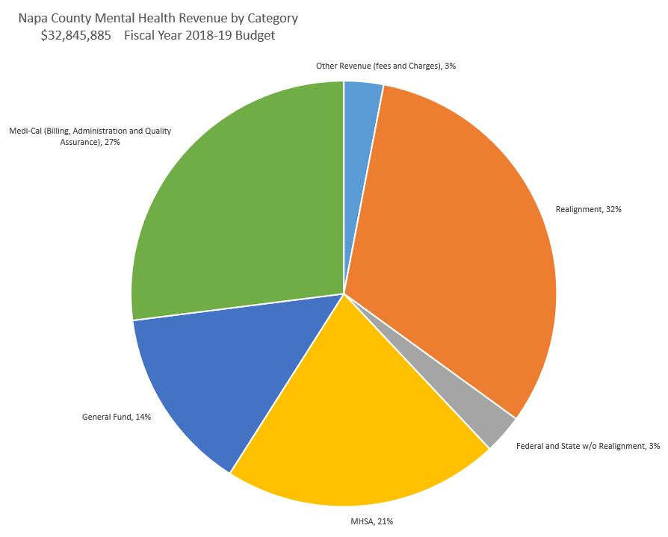
Napa County Mental Health Budget: REVENUE
Napa County Mental Health Revenue by Category Fiscal Year 2018-19 Budget = $32,845,885
Other Revenue (fees & charges), 3%
Medi-Cal (Billing, Administration & Quality Assurance), 27%
Realignment, 32%
General Fund, 14%
Federal & State w/o Realignment, 3%
MHSA, 21%

Slide 25
Napa County Mental Health Budget: EXPENDITURES
Napa County Mental Health Expenditures by Category Fiscal Year 2018-19 Budget = $32,845,885
Salaries & Benefits, 37%
Contracts, 48%
HHSA Administration, 9%
Services-including business travel & mileage, 1%
Supplies-including client support, 1%
Property Management, IT, Communications, 4%

Slide 26
Mental Health Services Act (MHSA) Proposition 63 passed in 2004
MHSA is funded by a 1% tax on CA incomes over $1 million

Slide 27
MHSA: Reasons for the Mental Health Services Act
Expand & Improve: The MHSA was created in 2004 by Prop 63 to expand and improve public mental health services.
Funding: CA public mental heath funding was insufficient to meet demand of 1/2 the population in need
Address Disparities: Cultural, racial and ethnic populations have been disproportionally affected
Placement: “Safety net” of underfunded system had become the criminal justice system, courts, and emergency rooms

Slide 28
MHSA: DEFINITION “Best Practices”, p. 19
Community Program Planning (CPP)
Community Services and Supports (CSS)
Prevention & Early Intervention (PEI)
Innovation (INN)
Capital Facilities & Technology Needs (CFTN)
Workforce Education & Training (WET)

Slide 29
MHSA: Funding & Components
Community Services and Support (CSS) 76%
Prevention and Early Intervention (PEI) 19%
Innovations (INN) 5%
MHSOAC Transparency Tool Suite: http://transparency.mhsoac.ca.gov

Slide 30
MHSA: Role of the Mental Health Board
Assure Citizen and Professional Involvement
MHSA Community Program Planning (CPP) is a state-mandated participatory process. Review local staff’s plans and execution of this process.
Review & Advise
Vote on substantive recommendations
A response is required from the mental/behavioral health staff through summary & analysis of recommendations (included in MHSA Plans/Updates).
Conduct Public Hearing
“Best Practices”, P. 18

Slide 31
Questions?
www.CALBHBC.org

