Slide 1
How to be an Effective Mental/Behavioral Health Advisory Board/Commission Membership, Meeting Rules, Duties & Tools 2024
The California Association of Local Behavioral Health Boards/Commissions supports the work of CA’s 59 local mental/behavioral health boards & commissions. www.calbhbc.org

Slide 2
Updates effective January 1, 2025
2
WIC Update - 2025: The following changes to CA WIC code are effective January 1, 2025). Summary of changes:
Youth Membership Requirement: 5604. (2)(B)(i) Fifty percent of the board membership shall be consumers, or the parents, spouses, siblings, or adult children of consumers, who are receiving or have received behavioral health services. One of these members shall be an individual who is 25 years of age or younger. (ii) At least 20 percent of the total membership shall be consumers, and at least 20 percent shall be families of consumers.
Local Education Agency Membership Requirement: 5604. (2)(D) (i) At least one member of the board shall be an employee of a local education agency. (ii) To comply with clause (i), a county shall notify its county office of education about vacancies on the board.
"Mental" is changed to "Behavioral", and advising regarding "substance use disorder" is added within the duties.

Slide 3
Topics
3
Membership
Meeting Rules & Conduct
Duties (WIC 5604.2) & Tools
Mental Health Services Act (MHSA): Role of Boards/Commissions
Review & Evaluate

Slide 4
Membership
4
50% Consumers (individuals with lived experience) or Family Members of Consumers
This must include at least: 20% Consumers One (1) who is 25 Years
20% Family Members of Consumers of Age or Younger (as of 1/1/2025)
One Board of Supervisor Member
One Employee from a Local Education Agency (as of 1/1/2025)
One Veteran or Veteran Advocate
Reflect the DIVERSITY* of the local client population
Individuals with experience & knowledge of the MH system, such as representatives of:
County Offices of Education
Large and Small Businesses
Hospitals, Hospital Districts
Physicians Practicing in Emergency Departments
City Police Chiefs
County Sheriffs
Community and Nonprofit Service Providers
Diverse membership includes ethnic, racial, cultural, LGBTQ+, age.
Additional Requirements: Best Practices Handbook, Pages 35 and 36

Slide 5
Meeting Rules
5
(PDF) (Doc) - www.calbhbc.org/brown-act

Slide 6
Conduct
6
Active Listening www.calbhbc.org/conduct
Focus on Issues
Person-First Language
No Swearing
No Personal Attacks or Criticism (of self or others).
One person speaks at a time – No side bars.
Keep Comments Short if possible—Do not monopolize.
Limit Acronyms –”When in doubt, spell it out.”
Silence Cell Phones

Slide 7
7
(1) REVIEW & EVALUATE the community’s public mental health needs, services, facilities, and special problems in any facility within the county or jurisdiction where mental health evaluations or services are being provided…
Review: Best Practices, Page 24
Recommendations: Best Practices, Page 20
Tools:
Speakers / Panels / Community Forums
Community organizations/agencies
Mental Health agency staff
Liaisons to other commissions/committees
Site Visits (p. 29 Best Practices)
Ad Hoc Committees (p. 3 Best Practices)
Performance Outcome Data

Slide 8
8
(2) REVIEW any county AGREEMENT entered into pursuant to Section 5650. The local mental health board may make RECOMMENDATIONS to the governing body regarding concerns identified within these agreements.
Review: Best Practices, Page 24
Recommendations: Best Practices, Page 20
Strategies:
1. Staff Presentations & Reports
Medi-Cal – Annual External Quality Review (EQRO Report): Review “Recommendations” and “Performance Improvement Plans” Sections.
MHSA - Mental Health Services Act Plan / Update / INN
SAMHSA Grants
PATH - Projects for Assistance in Transitions from Homelessness Grant
SAMHSA Block Grant
2. RFPs/RFAs*: Review new contract proposals
3. Site Visits: Review specific contract prior to visit
* RFP: Request for Proposal RFA: Request for Application

Slide 9
(3) ADVISE the Board of Supervisors and the local Mental Health Director regarding any aspect of the local mental health program.
9
1. IDENTIFY
Public Comment
Performance Outcome Data
Presentations (by staff, patients rights advocates, contractors)
Liaisons - MHB/C members can act as liaisons to other boards, commissions or committees.
2. RESEARCH
Ad Hocs (short-term workgroups) to conduct research meetings – P. 3 of Best Practices
Chair to meet regularly with Mental Health Director
Site Visits
3. ADVISE
Draft recommendations – P. 20 of Best Practices
Vote on recommendations

Slide 10
10
(4) Review and approve the procedures used to ENSURE CITIZEN and PROFESSIONAL INVOLVEMENT at all
stages of the planning process…
MH/BH Board & Commission Meetings
Publicize meetings and topics
Public Comment – Encourage public comment.
Accessible locations and times
Tools
Staff presentations re: the planning process
Staff reports and updates regarding plans and execution of MHSA Community Program Planning (CPP), Cultural Plans and Performance Improvement Plans
Attend Public Events – Board/Commission members to attend MHSA CPP events
Liaison(s) – Board/Commission member liaisons to the local BH/MH agency’s Cultural Committees, SALTs, Quality Improvement Committee
Review adopted MHSA Plans/Updates and Cultural Plans & Updates and make recommendations to ensure plans address the needs of the community.
Resources
MHSA Community Program Planning (CPP) Requirements, Best Practices, P. 20
Cultural Requirements, Best Practices, Page 11

Slide 11
11
(5) Submit an ANNUAL REPORT to the Board of Supervisors on the needs and performance of the county’s mental health system
ADVISE: Remember to Advise!
RESOURCES:
Best Practices, Page 5
www.calbhbc.org/reports

Slide 12
12
(6) Review and make recommendations on applicants for the appointment of a local MENTAL HEALTH DIRECTOR; the Board shall be included in the selection process prior to the vote of the governing body.
Review Job Description (Note: FAQs #10)
Review Applications
Participate on Interview Panels
More at FAQs #9:
www.calbhbc.org/faqs

Slide 13
13
(7) Review and comment on the county’s PERFORMANCE OUTCOME DATA and communicate findings to the California Behavioral Health Planning Council (CBHPC)
DATA NOTEBOOK (CA Behavioral Health Planning Council)
Examples
PERFORMANCE OUTCOME DATA
CALBHB/C Issue Brief
CALBHB/C Performance Compilation

Slide 14
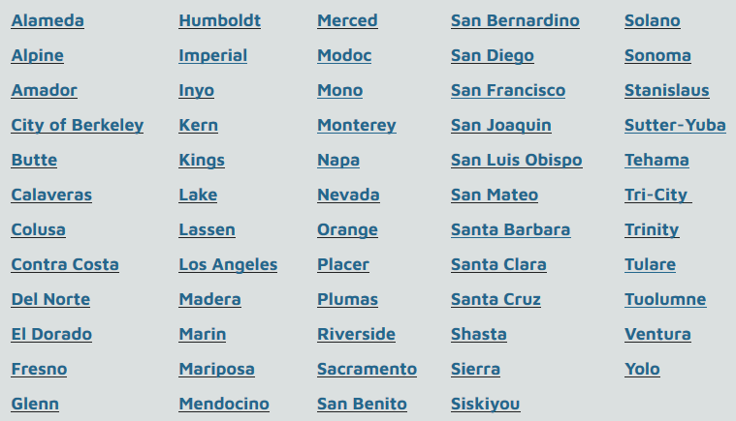
Tools for Staff & Stakeholders:
PERFORMANCE OUTCOME DATA
14
www.calbhbc.org/performance

Slide 15
15
(8) ADDITIONAL Duties or Authority & Assess REALIGNMENT
The Board of Supervisors may transfer additional duties or authority to a Mental Health Board
Assess the impact of the REALIGNMENT of services from the state to the county, to clients and on the local community
Realignment (1991): The money distributed from the state to the county to meet the costs of mental health services
Realignment (2011): The money distributed from the state to the county to meet the costs of Law Enforcement, Social Services and Behavioral Health

Slide 16
MHSA: Role of the Mental Health Board
16
Best Practices, Page 15 & 16
Assure Citizen and Professional Involvement
MHSA Community Program Planning (CPP) is a state-mandated participatory process. Review local staff’s plans and execution of this process.
CPP One-Pager includes: Definition, Participants & Process
Review & Advise
Vote on substantive recommendations
A response is required from the mental/behavioral health staff through
Incorporating recommendations in the MHSA Plan/Update
Summary & analysis of recommendations that are not included in MHSA Plans/Updates.
Conduct MHSA Public Hearings at the close of 30-day public
comment periods.

Slide 17
Review & Evaluate
17
Review: Best Practices, Page 24
Accessibility
Culturally Relevant
Scaled
Integrated
Communicated
Recommended Practices:
Client & Family Driven
Peer Providers are an essential component
Clients and family members are treated with dignity and respect and are included in decision-making
Program leadership and staff includes individuals with lived experience and family members (such as on non-profit boards and as employees)
Sustainability
Financially Viable
Workforce
Performance
Evidence-Based Practices: www.calbhbc.org/evidence-based-practices
Trauma-Informed Practices: www.calbhbc.org/evidence-based-practices
Community-Defined Evidence Practices: www.calbhbc.org/cultural-competence

Slide 18
18
CALBHB/C Resources
Resources
Brown Act (Open Meetings)
Conduct
Cultural Requirements
Hybrid Meetings
MHSA 3-Year Plans/Updates
Role, Components, Fiscal
Community Program Planning
Performance Outcome Data
Recommendations
Review
WIC: Duties, Membership
…. and more!
News/Issues
Newsletters
Issue Briefs (11) Issue Pages (31+)
Trainings (Recorded)
Chair & Admin Training
Mental Health Board
MHSA Community Program Planning
Performance & Fiscal
Unconscious Bias
5. Trainings (On-Line Modules)
Duties of local boards
MHSA: Role of MHB
MHSA: Fiscal
MHSA: CPP
6. Advocacy
Local
State/Federal
CA Association of Local Behavioral Health Boards and Commissions (CALBHB/C) supports the work of CA’s 59 local mental/behavioral health boards and commissions. www.calbhbc.org

