Slide 1
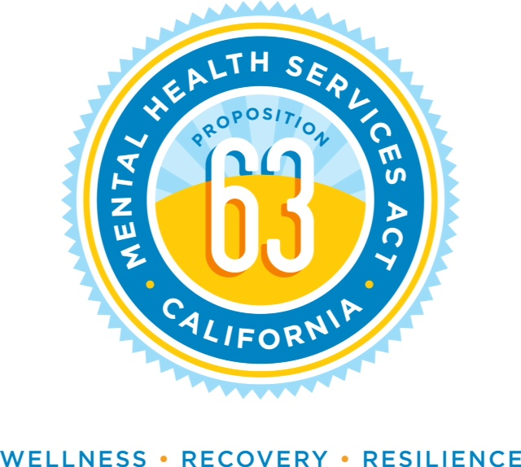
IPS IN ALAMEDA COUNTY BEHAVIORAL HEALTH CARE SERVICES
Napa County Mental Health Board
February 12th, 2018
Presented by Theresa Razzano – AC BHCS

Slide 2
IN 2011…
We joined the IPS Learning Community – The Dartmouth Johnson and Johnson Project
We had one IPS program serving about 50 people per quarter.

Slide 3
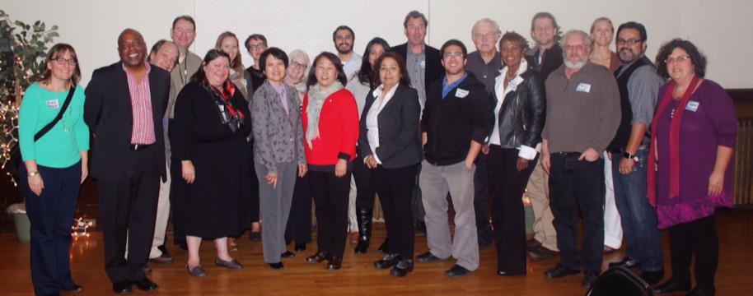
NOW…
We have ten IPS programs throughout Alameda County. 23 employment specialists provided services to 605 people in 2016-17.

Slide 4
WHY IPS?
In CA, only 10% of people in the public mental health system work. Poverty and lack of meaningful activity causes problems.
IPS helps 50% (or more) of people get jobs. People are 2.5 times more likely to get a job with IPS vs. traditional rehab programs.
People in IPS work longer stints, earn more money, and are more likely to become steady workers than people in traditional programs.
IPS works the best for people with SMI.

Slide 5
Evidence-Based Principles of IPS
Zero exclusion: eligibility is based on consumer choice.
IPS employment services are closely integrated with mental health treatment.
Competitive employment is the goal.
Personalized benefits and work incentives planning is provided.
The job search starts soon after a consumer expresses interest in working.
Employment specialists develop relationships with employers based on their consumers’ work preferences.
Follow-along supports are continuous.
Consumer preferences are honored.

Slide 6
TRADITIONAL ASSUMPTIONS | IPS ASSUMPTIONS
Screen for readiness | Zero exclusion
Stabilize first | Focus on client goals
Prepare stepwise | Rapid job search
Take available job | Consumer choice
Short-term support | Ongoing support
Keep employment and mental health services separate | Integrate employment and mental health services

Slide 7
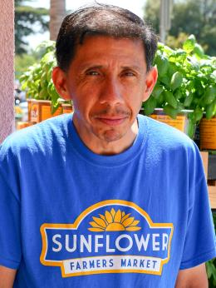
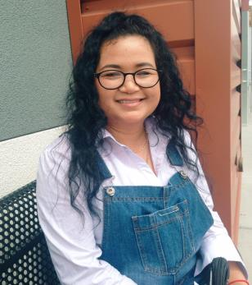
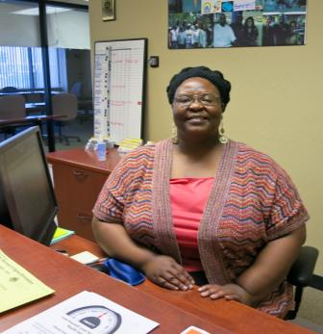
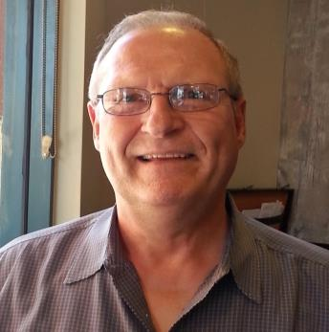
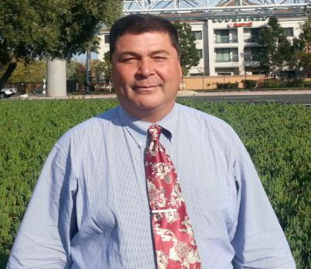
WE ALSO HAVE…
Strong support for IPS from executive, program, consumer, and family leaders in our County
Evidence-based practice pride!
An active IPS training unit
Cognitive remediation and supported education
Participation in the IPS Learning Community, along with 22 states/regions and 3 other countries

Slide 8
IPS PROGRAMS IN BHCS
Abode Greater HOPE
ACBHCS Vocational Program
Bay Area Community Services (6 programs)
Bonita House HOST and Casa Ubuntu
Building Opportunities for Self Sufficiency
East Bay Community Recovery Project FACT
Fred Finch Youth Center (4 programs)
PREP Alameda
Telecare CHANGES
Telecare STRIDES
CIL (benefits counseling)

Slide 9
IN 2016-17, OUR IPS PROGRAMS
Helped 605 people
275 people worked
235 new job starts
66 people participated in education programs
Enjoyed 13 IPS fidelity reviews, achieving fidelity scores ranging from 80 – 113
Achieved competitive employment rates ranging from 12 to 71%

Slide 11
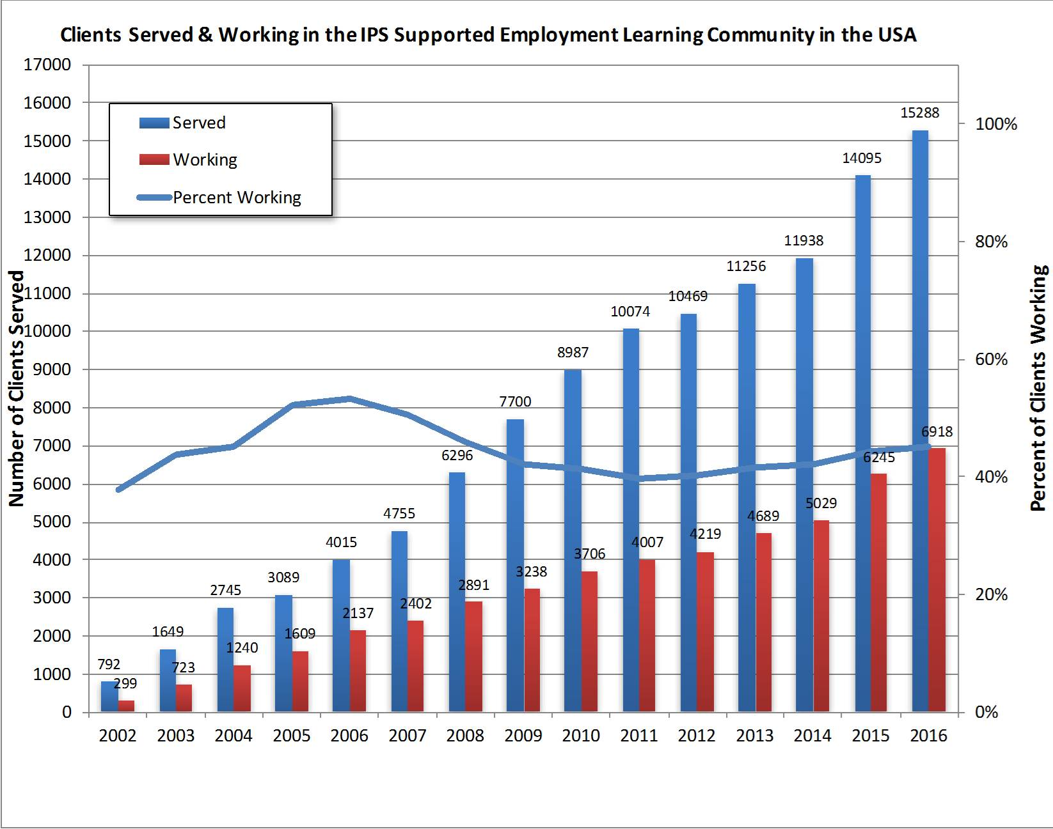

Slide 12
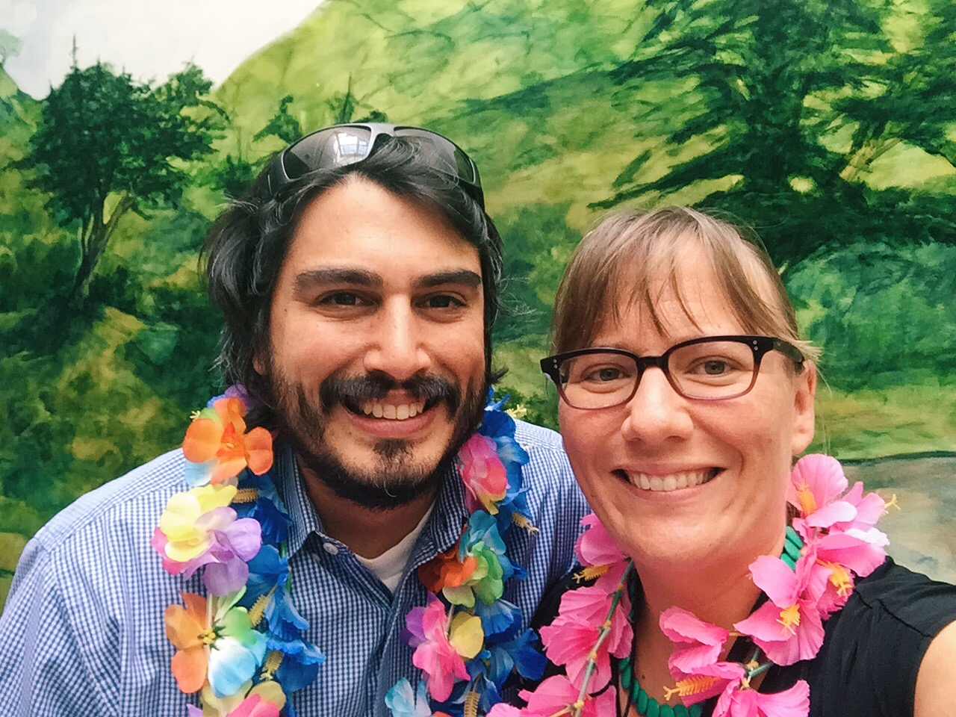
IPS Trainers and Implementation
They provide support and tools to
realign program services to IPS
They train IPS supervisors, employment specialists, and mental health teams
Trainers are responsible for doing fidelity reviews for quality improvement
And can develop learning
conferences and events

Slide 13
How to Leverage Funding to Get Started…..
Employment Specialists can bill 30-50% of their time to Medi-cal, since they are reducing mental health barriers for clients to achieve their employment goals
Department of Rehabilitation Co-op programs can identify funding dedicated to using the IPS model
MHSA funds support the “non-billable” tasks that employment staff are required to do
Moving towards… Incorporating IPS into the Medi-Cal Waiver for the state, so more programs can launch IPS programs

Slide 14
What We’ve Learned About Benefits…
When consumers know their insurance is covered, they are more open to “working past zero”.
Social Security has two Medi-Cal programs designed specifically for the working disabled
SSI recipients – 1619B
SSDI recipients – Medi-Cal for the Working Disabled (MWD)
1619B – allows recipients to earn up to $37,000 per year and maintain their Medi-Cal, MWD - $50,000
Training your county’s health insurance techs on how to manage SSI/SSDI benefits gets everyone on the right page sooner
This is all about recovery and Improved Quality of Life for our clients!!

Slide 15
Quotes from IPS Consumers:
I’m respected now.
I feel like I have a purpose now and every day I get up feeling good that I have a job.
I don’t wake up mad and upset anymore.
I feel better about myself now that I am working and contributing to society.
I’m doing exactly what I want to be doing. Now there is more peace and certainty in my life.
I like making money to help my family pay the bills.
I like being in mainstream society as opposed to living a sheltered life.
Working helps me manage my depression. My mood is more positive.

Slide 16
ON THE HORIZON… for Alameda County
Increased regional collaboration
IPS in Whole Person Care with HCSA
Possible expansion with TAY, SUD, and criminal justice populations
IPS in CalWorks
And more!

Slide 17
CONTACT INFORMATION
Theresa Razzano
Interim Division Director-Vocational Srvs.
Alameda County Behavioral Health Care
Theresa.Razzano@acgov.org
510-552-8587

